Slide 1


Word’s Heaven
Personalized e-Library and Book Recommender

Slide 2

Introduction
1
Word’s Heaven's Vision
2
AI-Powered Recommendations
Word’s Heaven is designed to revolutionize the reading experience by offering a personalized library that connects readers with books they'll love.
Our platform utilizes sophisticated AI algorithms to suggest books based on your reading history, preferences, and trending genres.
3
Immersive Experience
Words-Heaven goes beyond simple book storage, providing multimedia features like audiobooks and narrated videos for an enriched experience.

Slide 3
Problem Definition
In today’s digital age, a vast number of e-libraries provide users access to a wide array of books and resources. However, these platforms often lack personalization, dynamic engagement features, and comprehensive recommendations tailored to individual preferences and reading habits.
Lack of Personalization
Limited Discovery
Difficult Navigation
Traditional e-libraries often lack personalized recommendations, leading to a generic and unengaging reading experience.
Readers struggle to find books that align with their specific interests, resulting in frustration and disengagement.
Content is often scattered and disorganized, making it challenging for users to find books that match their preferences.

Slide 4

Objectives
Personalized Recommendations
Multimedia Engagement
Use AI to suggest books tailored to individual reading habits and preferences, providing a tailored experience.
Integrate audiobooks and narrated videos, creating an immersive and engaging experience for users.
Cross-Platform Accessibility
Enhanced Book Discovery
Ensure seamless access across all devices, allowing users to enjoy their library on any device.
Help users explore new genres and titles with dynamic recommendations and community insights.

Slide 5
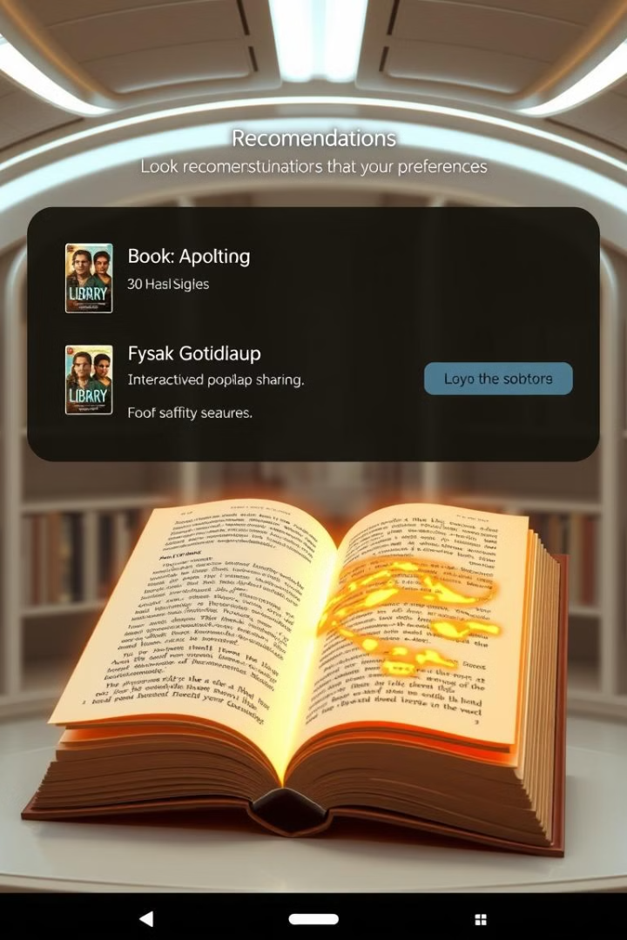




Uniqueness
AI-Driven Recommendations
Audiobooks & Narrated Videos
Our advanced AI algorithms provide tailored book suggestions based on user behavior and reading history.
Experience immersive multimedia through narrated audiobooks and videos, enhancing the reading experience.
Cross-Platform Access
Real-Time Book "Heat Maps"
Enjoy your library on any device, with seamless access and synchronized content across platforms.
Visual highlights of popular book sections, providing insights into trending content and boosting engagement.

Slide 6
Technologies
Backend
Java Spring Boot / .NET
Frontend
React
Database
MySQL
Recommendation Engine
Scikit-learn

Slide 7

Advantages
1
Enhanced User Experience
2
Content Versatility
Combines text, audio, and video formats to cater to diverse reading preferences and enhance engagement.
Personalized recommendations foster engagement and interaction with content, leading to a more enjoyable experience.
3
Ease of Discovery
4
Cross-Platform Accessibility
AI-driven suggestions help users explore new genres and broaden their reading scope, fostering intellectual growth.
Access your library on any device, offering convenience and flexibility to users on the go.

Slide 8



Disadvantages
Initial Development Time and Costs
Building AI-driven recommendations, multimedia integration, and a scalable database can be time-consuming and costly.
Ongoing Maintenance and Updates
Regular content updates, feature enhancements, and server maintenance are essential, requiring continuous resource allocation.

Slide 9

Thank You
We believe Words-Heaven has the potential to revolutionize the reading experience. Your investment will help us bring this innovative platform to life, fostering a love for reading in a dynamic and personalized way.

